Slide 1
Case Study
Bright Enterprises sometimes buys goods from suppliers in countries like China and Japan. They send invoices in their currencies (Chinese Yuan and Japanese Yen) and the company needs to pay in the same currency.
They also sell to customers in sell our goods to foreign countries like
United Arab Emirates (UAE) and African countries (Kenya, Tanzania) in US Dollars ($)
United Kingdom (UK) in Pound Sterling (₤)
and receive money in same currency…
Notes:
Basically the company buys and sells in multiple currencies.

Slide 2
Challenges of Bright Enterprises
Keeping track of many foreign currencies
Identifying each transaction in both the foreign currency and local currency
Keeping track of the exchange rates
Exchange rates change everyday and calculation of gain or loss from foreign exchange transactions is a tedious job
Adjusting the unadjusted forex gain or loss caused due to fluctuation in exchange rates

Slide 3
Multi-currency
In this session, you will learn how MULTI-CURRENCY feature can help Bright Enterprises handle their FOREX TRANSACTIONS

Slide 4
Learning Outcomes
At the end of this session, you should be able to:
1. Understand the meaning for multi-currency
2. Understand the meaning of realized and unrealized forex gain or loss
3. Implement multi-currency in Tally for Bright Enterprises
4. Find out and adjust the forex gain or loss using journal adjustment entry
Notes:
At the end of this session, you should be able to :
1. Understand the meaning for multi-currency
2. Understand the meaning of realized and unrealized forex gain or loss
3. Implement multi-currency in Tally for Bright Enterprises
4. Find out and adjust the forex gain or loss using journal adjustment entry

Slide 5
What are Multi-currency transactions ?
Notes:
Question to audience – What do you think multi-currency is?

Slide 6
What are Multi-currency transactions ?
Any transaction done by a company in a currency which is other than a local currency can be termed as “Foreign currency”.
Example: When Bright Enterprises (India) operates in Indian Rupees (₹) which is their local currency. They either,
Sell goods to foreign countries in Foreign currencies ($, ₤, ¥) or
Buy goods from foreign countries in Foreign currencies ($, ₤, ¥)
So $, ₤, ¥ are the multiple currencies that the company deals in.

Slide 7
Effect of Multi-currency transactions
Gain / Loss arises due to fluctuations in forex conversion rates
Realized and Unrealized Gain / Loss in Balance Sheet as on date
Need to adjust Gain / Loss to Profit and Loss Account
Manage bill-wise details in foreign currency for payables and receivables
Affects Foreign currency Bank account balances due to fluctuation in currency rates
Notes:
Let us understand each point in detail.

Slide 8
What is forex gain or loss ?
An exchange gain or loss is caused by a change in the exchange rate used such as when an invoice is entered at one rate and paid or received at another rate, this will generate an exchange gain or loss
Example:
Purchased goods on 1st April 2018 in US Dollars ($) at ₹ 65 / 1 $
Paid supplier on 20th May 2018 in US Dollars ($) at ₹ 68 / 1 $
What is the forex gain or loss from this transaction ?
Notes:
Question to audience

Slide 9
Calculation for Example
Transaction | Rate of exchange
Purchase (1st April) | ₹ 65 / 1 $
Payment (20th May) | ₹ 68 / 1 $
Foreign exchange loss | ₹ 3 / 1 $
Forex exchange loss of ₹ 3 / 1 $ due to fluctuation i.e., fall of Indian Rupee against US Dollar from ₹ 65 to ₹ 68

Slide 10
What is realized forex gain/loss ?
Realized forex gains or losses are from completed forex transactions.
Example:
Purchased goods on 1st April 2018 in US Dollars ($) at ₹ 65 / 1 $
Paid supplier on 20th May 2018 in US Dollars ($) at ₹ 68 / 1 $
Realized forex exchange loss is ₹ 3 / 1 $ due to fluctuation i.e., fall of Indian Rupee against US Dollar Rupees from ₹ 65 to ₹ 68

Slide 11
What is Unrealized forex gain/loss ?
Unrealized gain or losses refer to profits or losses that have occurred on paper, but the relevant transactions have NOT been completed.
Example:
Purchased goods on 1st April 2018 in US Dollars ($) at ₹ 65 / 1 $
Purchased goods on 20th May 2018 in US Dollars ($) at ₹ 68 / 1 $
Unrealized forex exchange loss as on 20th May 2018 is ₹ 3 / 1 $ due to fluctuation i.e., fall of Indian Rupee against US Dollar from ₹ 65 to ₹ 68
Note that the transaction is NOT complete as of 20th May 2018, but there is a forex exchange loss assuming that if 1st April 2018 invoice paid today, we will incur loss.
Notes:
You can also call an unrealized gain or loss a paper profit or paper loss, because it is recorded on paper but has not actually been realized..
The conversion occurs at 3 stages:
When Bright Enterprises creates or receive the invoice
The date on which the accounting period ends (If it is defined in the Currency master OR rate captured in the 2nd transaction)
When you settle the invoice

Slide 12
Forex Gain vs Forex Loss
Forex Gain
Forex Loss
Transaction 1 | Rate of exchange
Purchase (1st April) | ₹ 65 / 1 $
Payment (1st May) | ₹ 63 / 1 $
Forex Gain | ₹ 3 / 1 $
Transaction 3 | Rate of exchange
Purchase (1st April) | ₹ 65 / 1 $
Payment (20th May) | ₹ 68 / 1 $
Forex Loss | ₹ 3 / 1 $
Transaction 2 | Rate of exchange
Sale (1st April) | ₹ 65 / 1 $
Receipt (18th May) | ₹ 67 / 1 $
Forex Gain | ₹ 2 / 1 $
Transaction 4 | Rate of exchange
Sale (1st April) | ₹ 65 / 1 $
Receipt (2nd May) | ₹ 63.5 / 1 $
Forex Loss | ₹ 1.5 / 1 $

Slide 13
Multi-currency in Tally
Discover Yourself!!
Notes:
Let the participants self-explore. Ask them to refer the exercise given in the workbook and try it in Tally.

Slide 14
Implement Multi-currency in Tally
1
MAINTAIN Enable foreign currencies and maintain their Exchange Rates
3
FOREX GAIN/LOSS Identify the gain/loss from forex transactions
2
TRANSACT with different currencies
4
ADJUST FOREX GAIN/LOSS Unadjusted forex gain/loss adjustment
1
Enable Multi-currency and Create foreign currencies required for the business i.e., $, ₤, ¥
2
Record multi-currency transactions using currency exchange rates as per prevailing rates – Purchase and Payment, Sales and Receipt…
3
Check reports for Unadjusted Gain or Loss reported in Balance Sheet
4
Adjust the forex gain/loss using the journal adjustment class
Notes:
ENABLE & CREATE
Create Currency Master GOT → Create → Currency
TallyPrime intuitiveness will prompt to enable the feature in Company. Just say Yes and continue
GOT → Create → Currency → Set ‘Enable multi-currency’ to ‘Yes’
Then create currencies as needed with Symbols and Formal Name
Ways to create currencies
1st
Type from Keyboard like ‘$’, AED (Arab Emirates Dirhams), SAR (Saudi Arabian Riyal), KSh (Kenyan Shillings), etc.,
2nd
Type short cut keys in Key Board and Tally will pick symbols like -
(£ Pound Sterling - Alt + 156)
(€ Euro - Alt + 0128)
(¥ Japanese Yen Alt + 0165)
3rd
Copy from Character Map from System Tools and paste it in Tally
2. TRANSACT
During any transaction specify the currency and then the exchange rate screen pops up, specify the exchange rate here. You can print the invoice as per your requirement of displaying the base currency or not. Press Ctrl+P and C : Configure. Type ‘Base Currency… and you find the option ‘Print base currency and foreign currency for total?’ use Press Enter to toggle to Yes and then Escape. Without this option, the invoice prints only in foreign currency.
3. VIEW UNADJUSTED FOREX GAIN/LOSS
After a Purchase and Payment, or multiple purchases with different rates of exchange, you will be able to see a forex gain/loss in the Balance Sheet, the Trial Balance and the ledger reports.
Also, you can view Ledger reports for forex transaction with the F12 configurations ‘Show forex details also’
And to view ‘Show forex transactions only’ Click on Basis of Value Button.
4. ADJUST
The unadjusted forex gain/loss needs to be adjusted and its impact will be visible in the profit and loss a/c after the adjustment.
To adjust it, go to ‘Journal’ voucher alteration screen and create a ‘Forex adjustment’ class and enable the option ‘Use class for forex gain/loss adjustments?’
Create the ‘Forex gain/loss’ ledger under ‘Indirect Incomes/Expenses’

Slide 15
Completed Foreign Currency Transaction
Exercise 1
Bright Enterprises had the below completed (payment completed) Foreign Currency transaction with ‘Sharaf DG LLC’ from UAE (Dubai)
Date | Transaction Type | Foreign Currency | Exchange Rate | Invoice Amount (in Foreign Currency) | Invoice Amount (in Local Currency)
1-Jul | Purchase | $ | 68 / $ | $1,000 | 68,000
1-Aug | Payment | $ | 70 / $ | $1,000 | 70,000

Slide 16
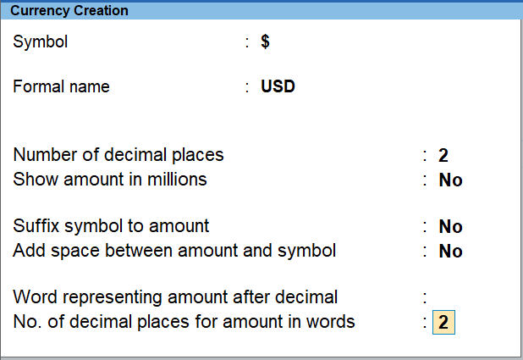
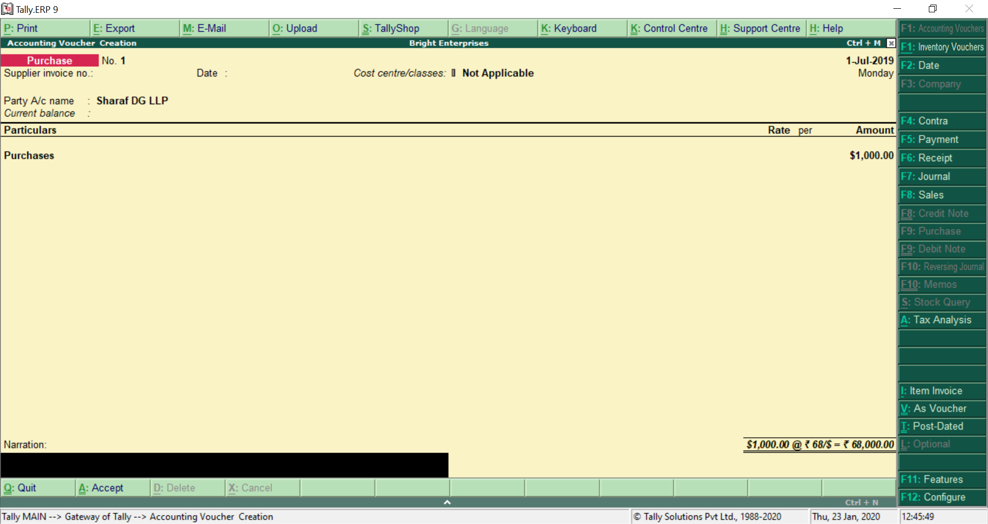
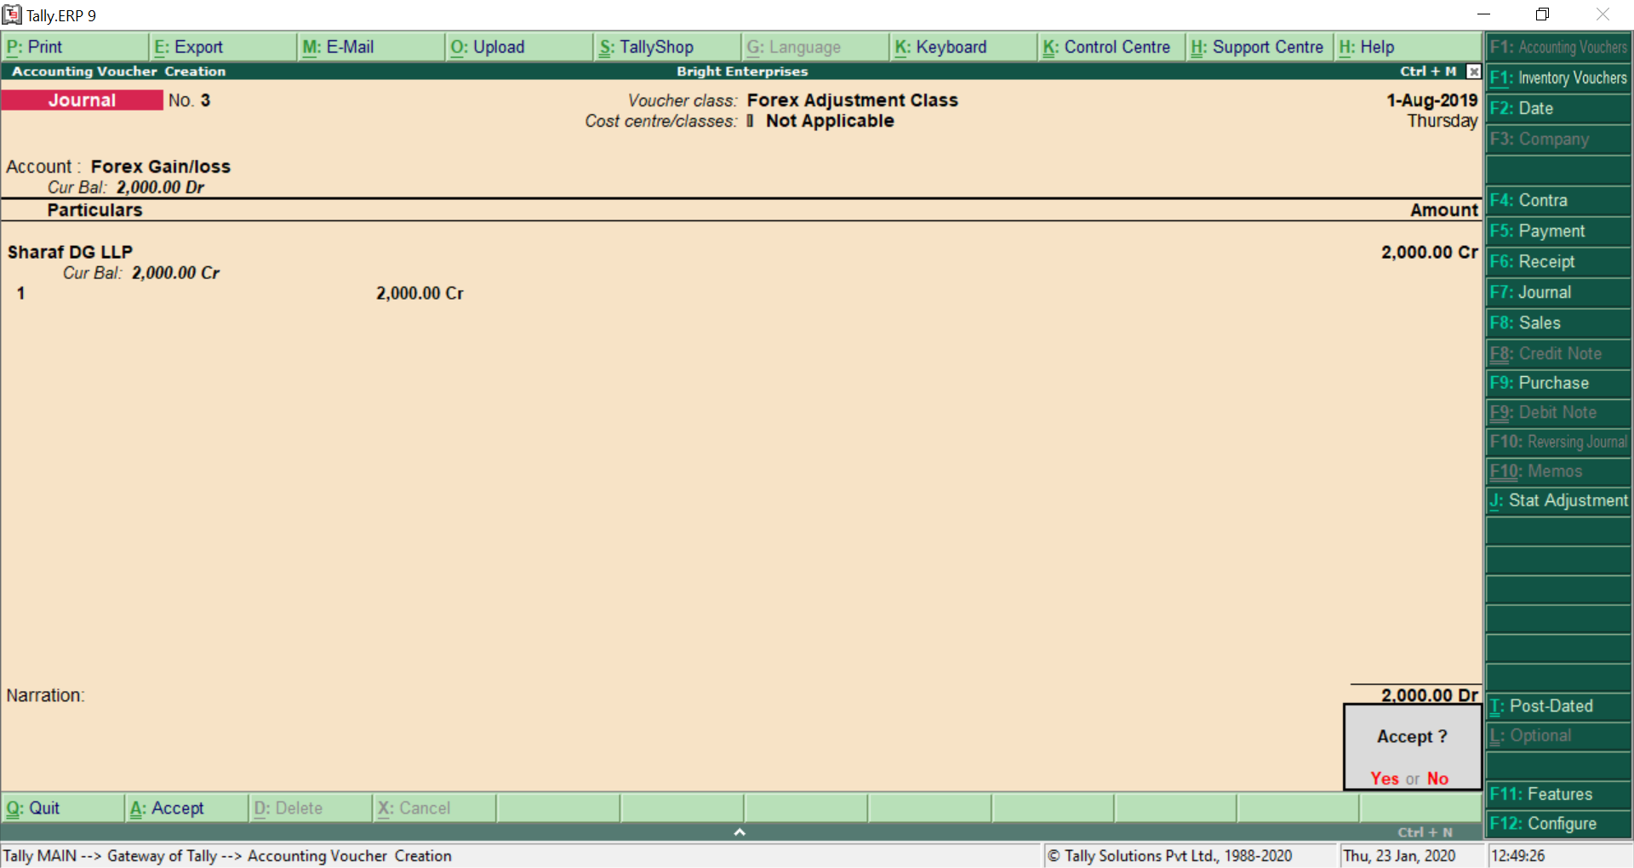
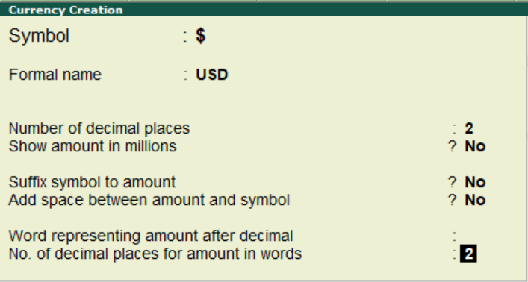
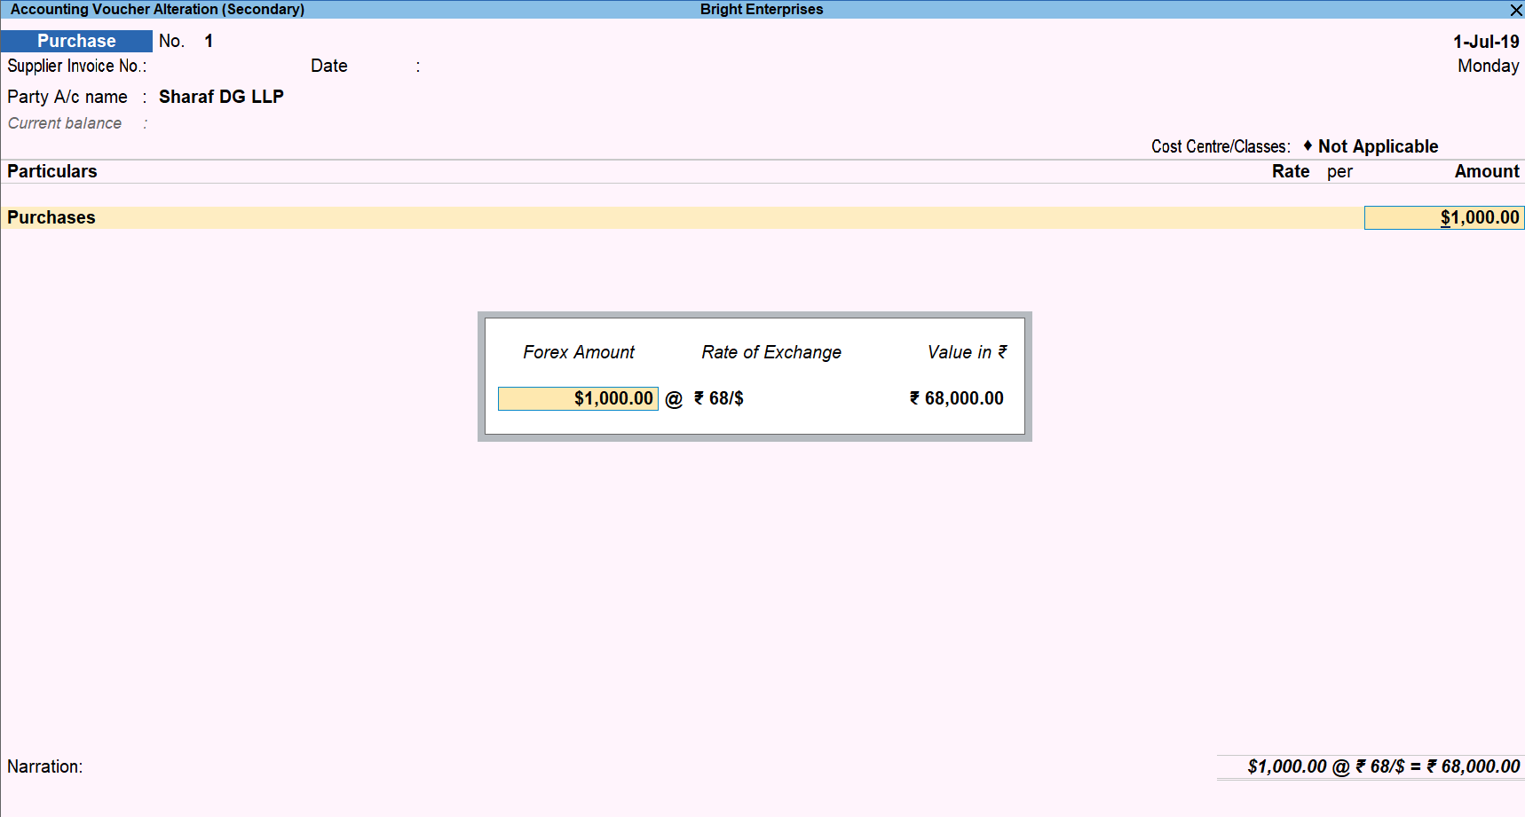
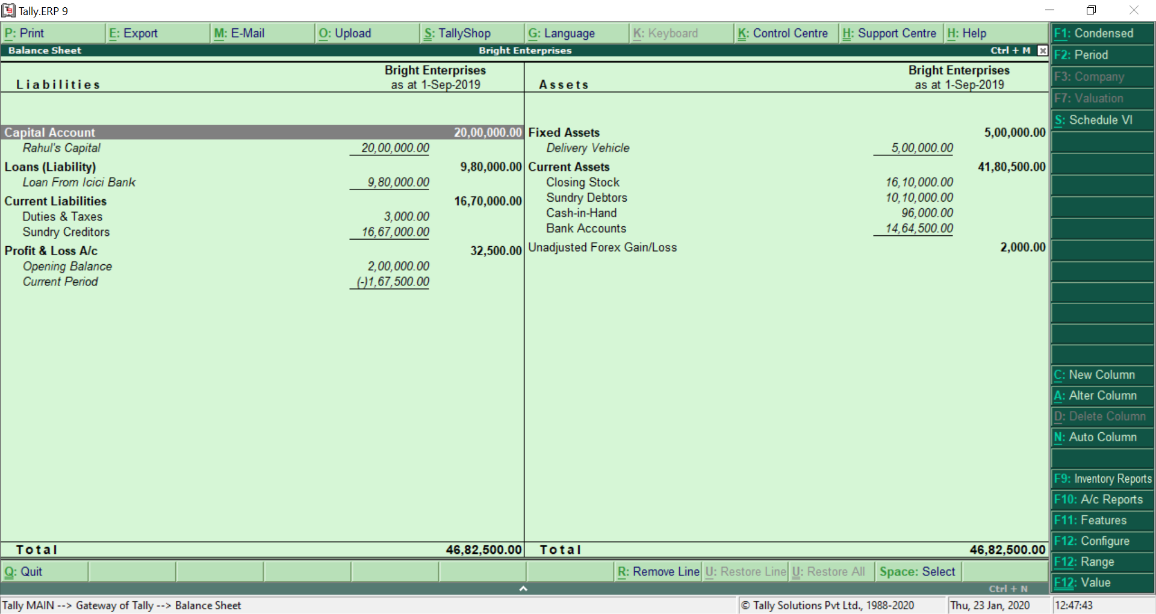
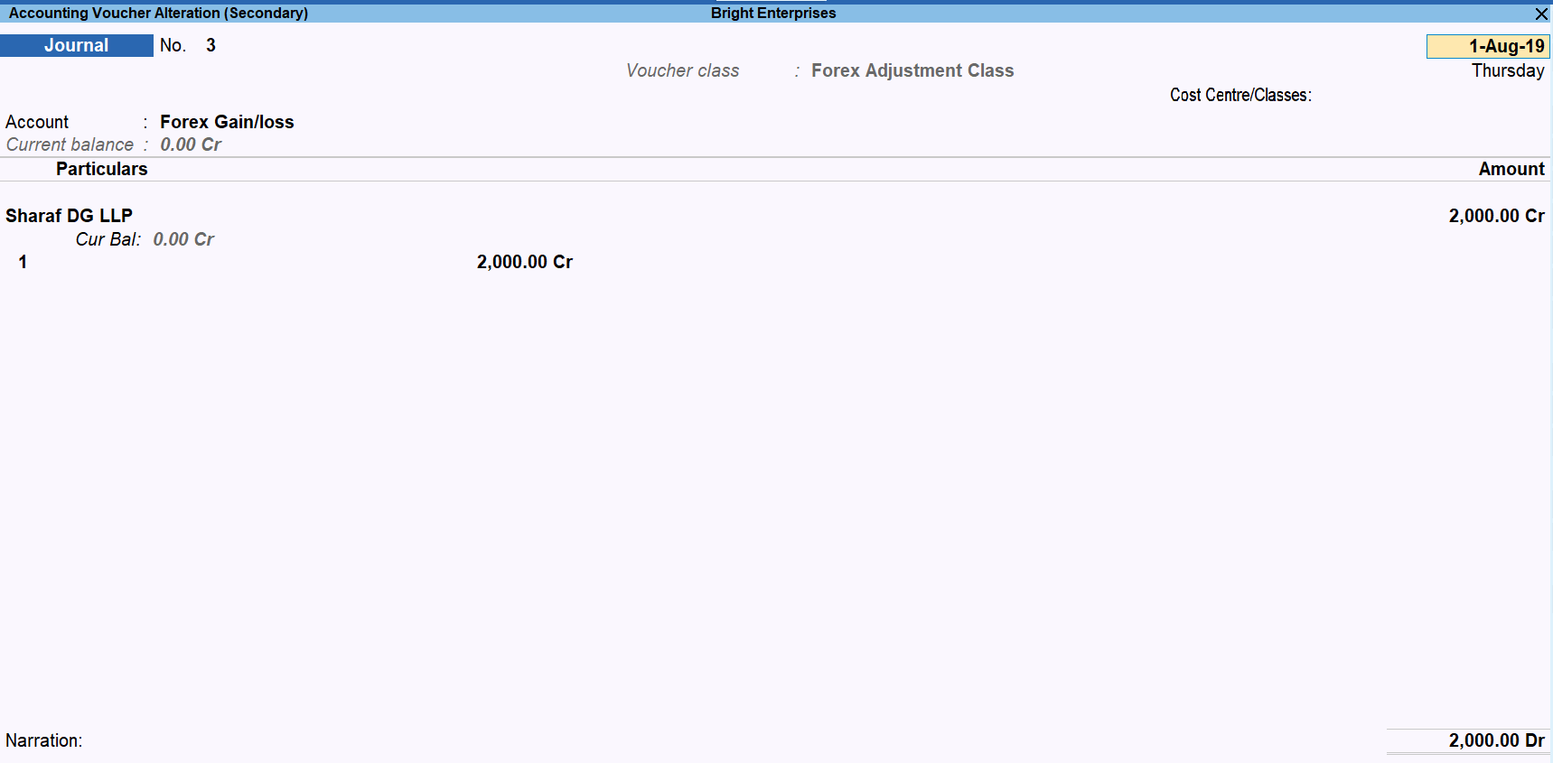
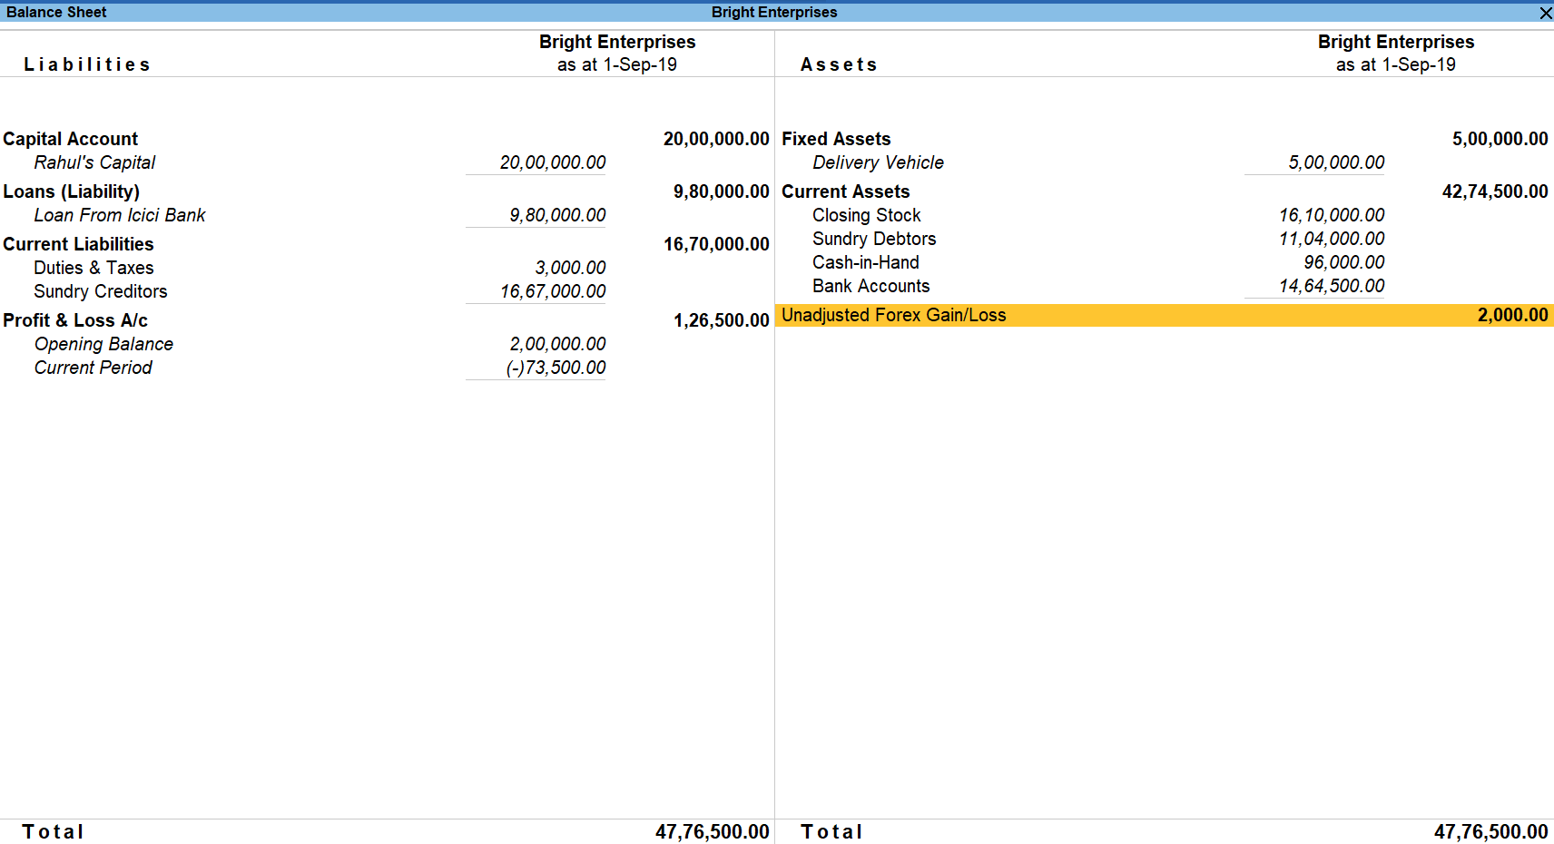
Multi-currency in Tally
1
ENABLE & CREATE
(Enable multi-currency in F11 and create $ Currency)
3
VIEW UNADJUSTED FOREX GAIN/LOSS
View the Balance Sheet for this
2
TRANSACT
(Record transactions and specify the exchange rates)
4
ADJUST
Record the adjustment entry using journal class
Notes:
Enable and Create
GOT → Create → Currency → Set ‘Enable multi-currency’ to ‘Yes’
Ways to create currencies
1st
Type from Keyboard like ‘$’, AED (Arab Emirates Dirhams), SAR (Saudi Arabian Riyal), KSh (Kenyan Shillings), etc.,
2nd
Type short cut keys in Key Board and Tally will pick symbols like -
(£ Pound Sterling - Alt + 156)
(€ Euro - Alt + 0128)
(¥ Japanese Yen Alt + 0165)
3rd
Copy from Character Map from System Tools and paste it in Tally
2. Specify exchange rates and transact
Pass the purchase and payment transaction by specifying the respective rates of exchange
3. View unadjusted forex gain/loss
View the Balance sheet and see the balance Rs. 2000 against ‘Unadjusted forex gain/loss’ . This is a system calculated field based on the transactions passed.
You can drill down on the Balance sheet line item ‘Unadjusted forex gain/loss’ to see the transaction wise forex gain/loss as well
4. Adjust
Record the adjustment entry for the forex gain/loss. Then again view the Balance Sheet to find that the line ‘Unadjusted forex gain/loss’ has disappeared. Also, check the profit and loss account to see that the gain/loss now impacts this account.

Slide 17
Enable Feature (F11) -> Accounting -> Multi-Curency
Create Currency : Master -> Accounting Info -> Currency
Maintain exchange rate
Create Party Account and mention currency ledger
Create Forex Gain or Loss Account under Indirect Expense
Transact (Sale/Purchase, Receipt/Payment), View Balance Sheet, P&L & Party Ledger
Alter Journal Voucher to add a class for Forex Adjustment
Add Journal Voucher for Adjustment
View reports.

Slide 18
Balance Sheet

Slide 19
Incomplete Foreign Currency Transaction
Exercise 1
Bright Enterprises had the below transaction with ‘Appliances Direct Midlands Store’ based in Derbyshire, United Kingdom. Money is yet to be received from the customer for the sale.
Date | Transaction Type | Foreign Currency | Exchange Rate | Invoice Amount (in Foreign Currency) | Invoice Amount (in Local Currency)
2-Aug-2018 | Sales | £ | 91 / £ | £ 1000 | 91,000
1-Sep-2018 | Sales | £ | 94 / £ | £ 1000 | 94,000
They want to print the invoice in pound.
Notes:
The adjustment for incomplete foreign currency transactions is usually recorded at the end of the financial period.
Incomplete just refers to the fact the payment towards the transaction has not been made/received.

Slide 20
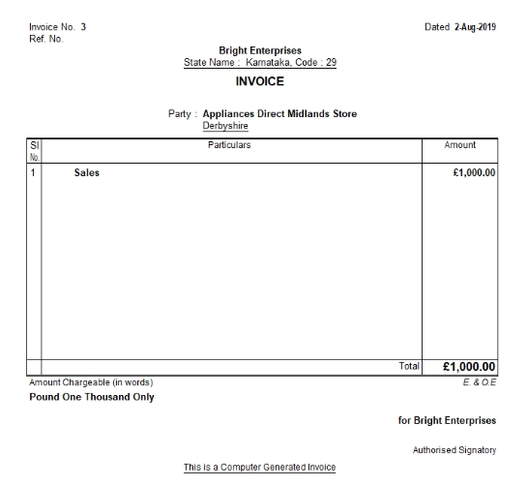
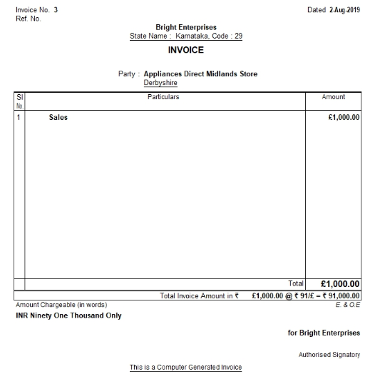
Sale Invoice Print
Notes:
Using the Print F12 configuration –’Print base and foreign currency for total’, you will be able to see the second invoice.

Slide 21
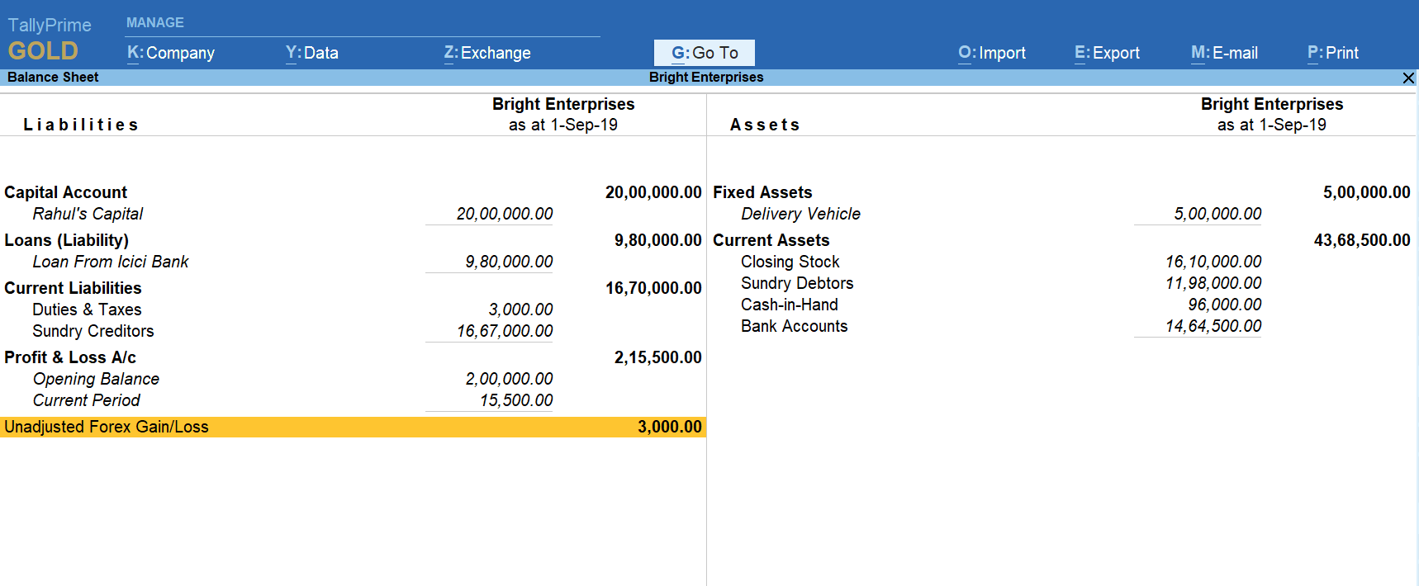
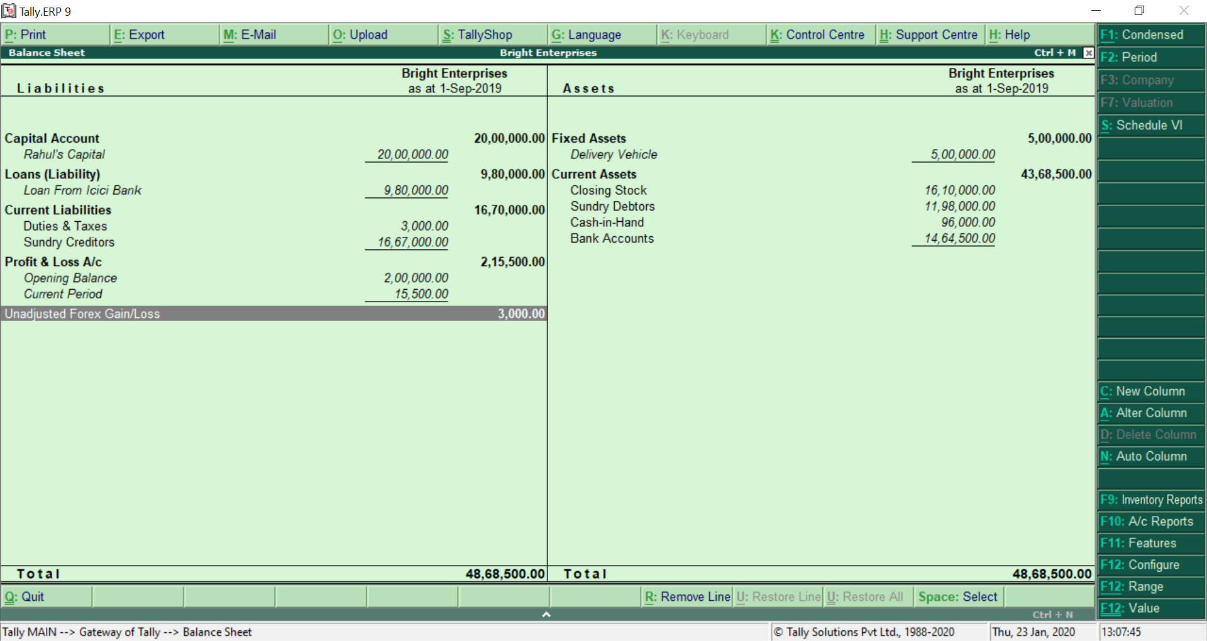
Balance Sheet

Slide 22
Quiz
Multi-currency
Notes:
Allow the participants to write the answers in their workbook. This will be a silent quiz. Answers will be discussed only at the end of the quiz.

Slide 23
‘Realized Forex Gain or Loss’ arises, when _____________
Foreign currency transaction is not complete and there is fluctuation in forex rates
Foreign currency transaction is not complete and there is no fluctuation in forex rates
Foreign currency transaction is complete, and there is fluctuation in forex rates
Foreign currency transaction is complete, and there is no fluctuation in forex rates

Slide 24
In ledger report, when we have set F12 Configuration to get Foreign Currency details for one ledger, how do you switch over to other ledger with same configuration? _____________
F10 : Accounting Reports
F8 : Related Reports
F9 : Inventory Reports
F4 : Ledger

Slide 25
In ledger report, when we want to view the report with Foreign Currency, we use the option of ___________
Ctrl + H : Change View
Ctrl + B : Basis of Value
Ctrl + J : Exception Reports
F8 : Columner

Slide 26
Bright Enterprises can adjust the forex gain or loss in Tally by _________
Receipt Voucher
Journal Voucher
Profit and Loss account
Payment

Slide 27
Answers
Multi-currency

Slide 28
‘Realized Forex Gain or Loss’ arises, when _____________
Foreign currency transaction is not complete and there is fluctuation in forex rates
Foreign currency transaction is not complete and there is no fluctuation in forex rates
Foreign currency transaction is complete, and there is fluctuation in forex rates
Foreign currency transaction is complete, and there is no fluctuation in forex rates
Foreign currency transaction is complete, and there is fluctuation in forex rates

Slide 29
In ledger report, when we have set F12 Configuration to get Foreign Currency details for one ledger, how do you switch over to other ledger with same configuration? _____________
F10 : Accounting Reports
F8 : Related Reports
F4 : Ledger
F9 : Inventory Reports
F4 : Ledger

Slide 30
Bright Enterprises can adjust the forex gain or loss in Tally by _________
Receipt Voucher
Journal Voucher
Profit and Loss account
Payment

Slide 31
RECAP
Simplicity of Tally in creating different Currencies required – 3 ways to do it
Flexibility of providing currency exchange rates in 3 different ways → 1. while recording transactions, 2. currency master and 3. rates of exchange menu
Creating forex adjustment journal class for easy filter of customers / supplier's ledger who are affected by Forex Gain or Loss
Understood the difference between Realized and Un-reailzed Gain or Loss and treatment of them in the books of accounts

